Slide 2
Declaration of Interests
Employed by the European Centre for Disease Prevention and Control (ECDC), Stockholm
No other interests to disclose

Slide 3
Data availability on the continuum of care 2014 (n=40); 2016 (n=44); 2018 (n=43)
Source: ECDC. Dublin Declaration monitoring 2018; validated unpublished data.

Slide 4
Fast Track Targets by 2020
Target 1
Target 2
Target 3
Overall target
73%
of all people living with HIV
VIRALLY SUPPRESSED
=
living with HIV
DIAGNOSED
diagnosed with HIV
ON ART
on ART
VIRALLY SUPPRESSED

Slide 5
Progress toward achieving the first 90: Target 1: 90% of all PLHIV who know their status (n=39)
Global target 90%
Regional average 80%
West 86%
Centre 83%
East 76%
Source: ECDC. Dublin Declaration monitoring 2018; validated unpublished data.

Slide 6
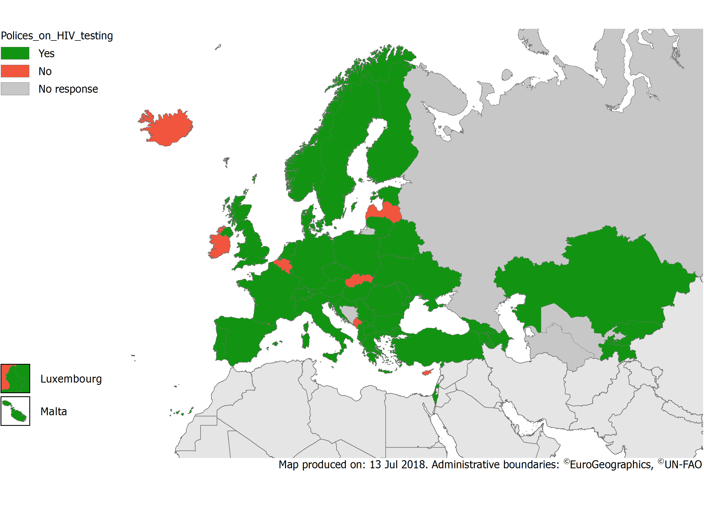
Countries having national policies or guidelines that cover HIV testing interventions and strategies, 2018
Source: ECDC. Dublin Declaration monitoring 2018; validated unpublished data.

Slide 7
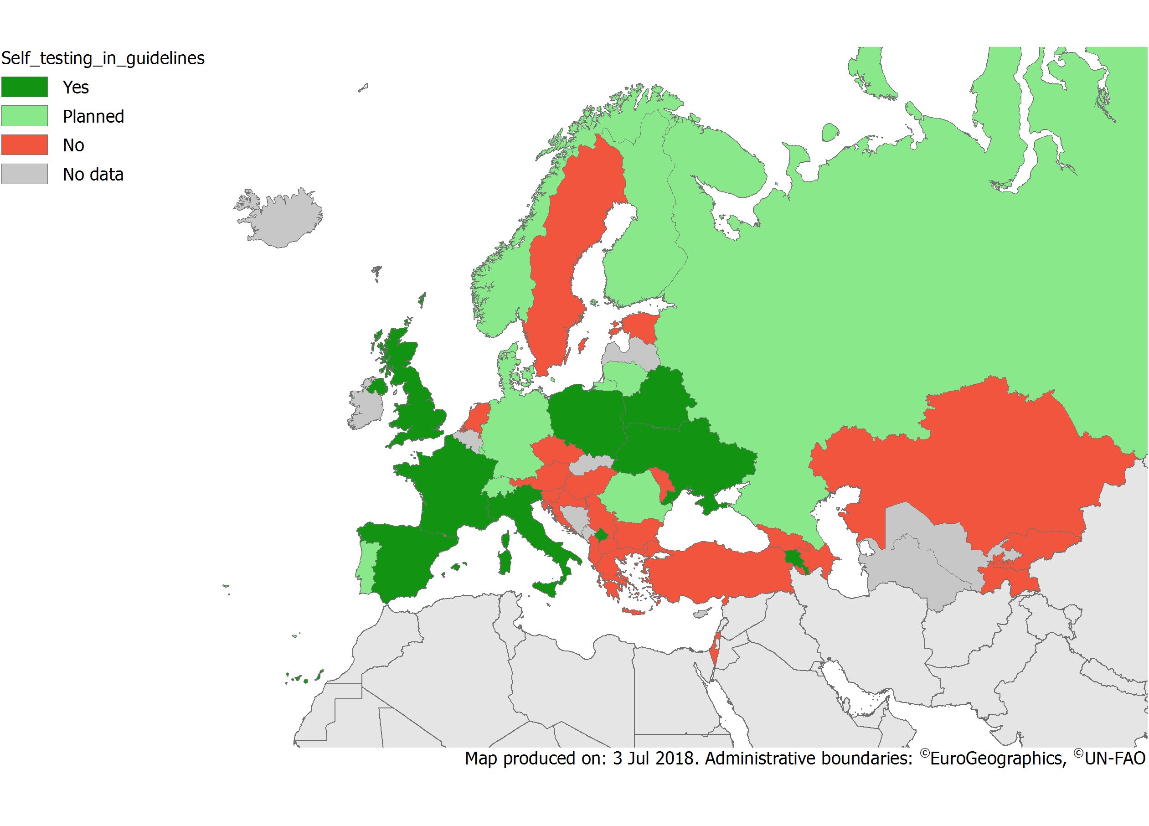
Inclusion of self-testing in national HIV testing guidelines, 2018
Source: ECDC. Dublin Declaration monitoring 2018; validated unpublished data.

Slide 8
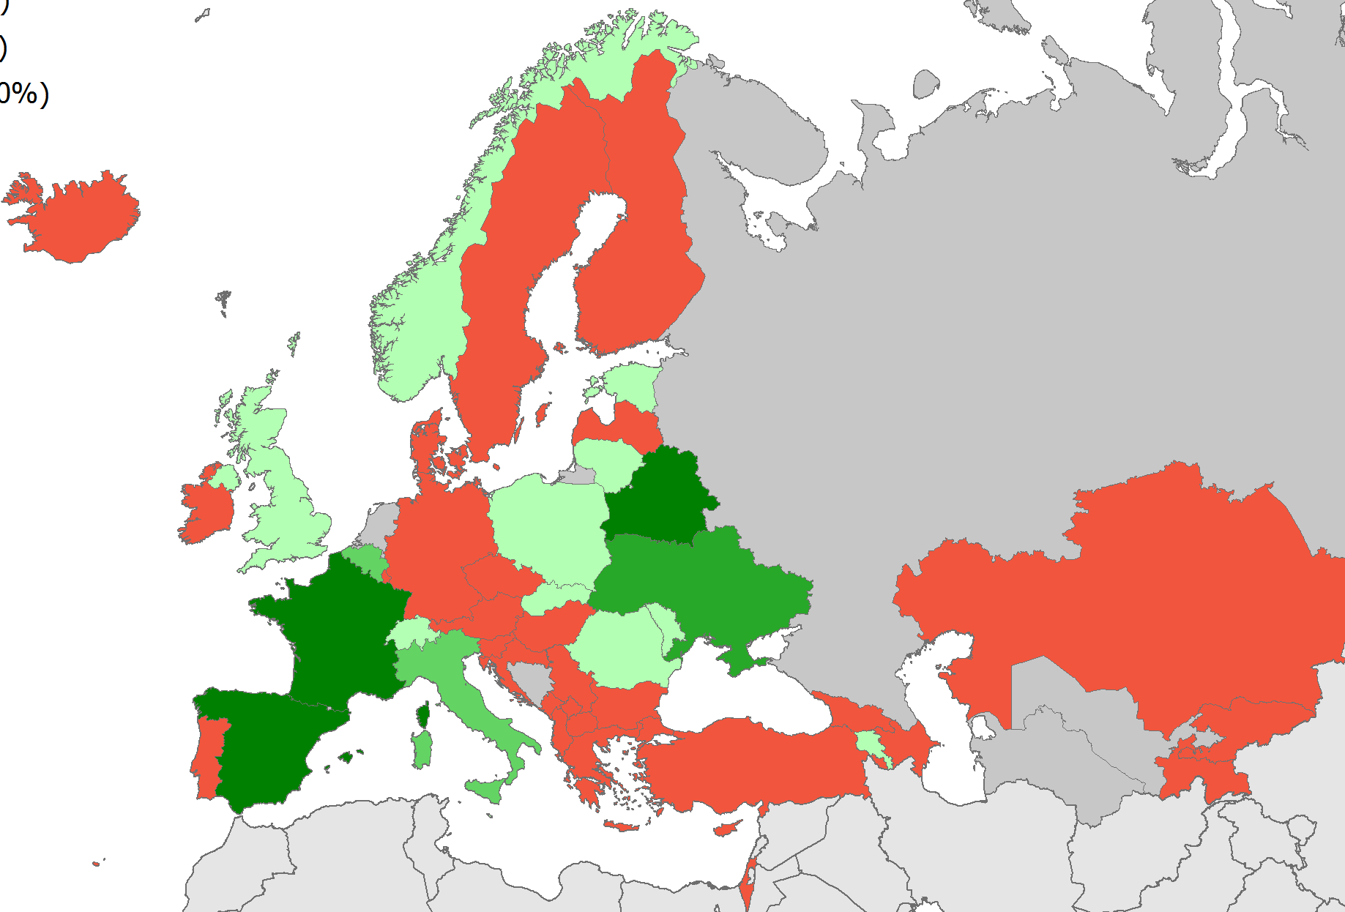
Implementation of self-testing in Europe and Central Asia, 2018
Source: ECDC. Dublin Declaration monitoring 2018; validated unpublished data.

Slide 9
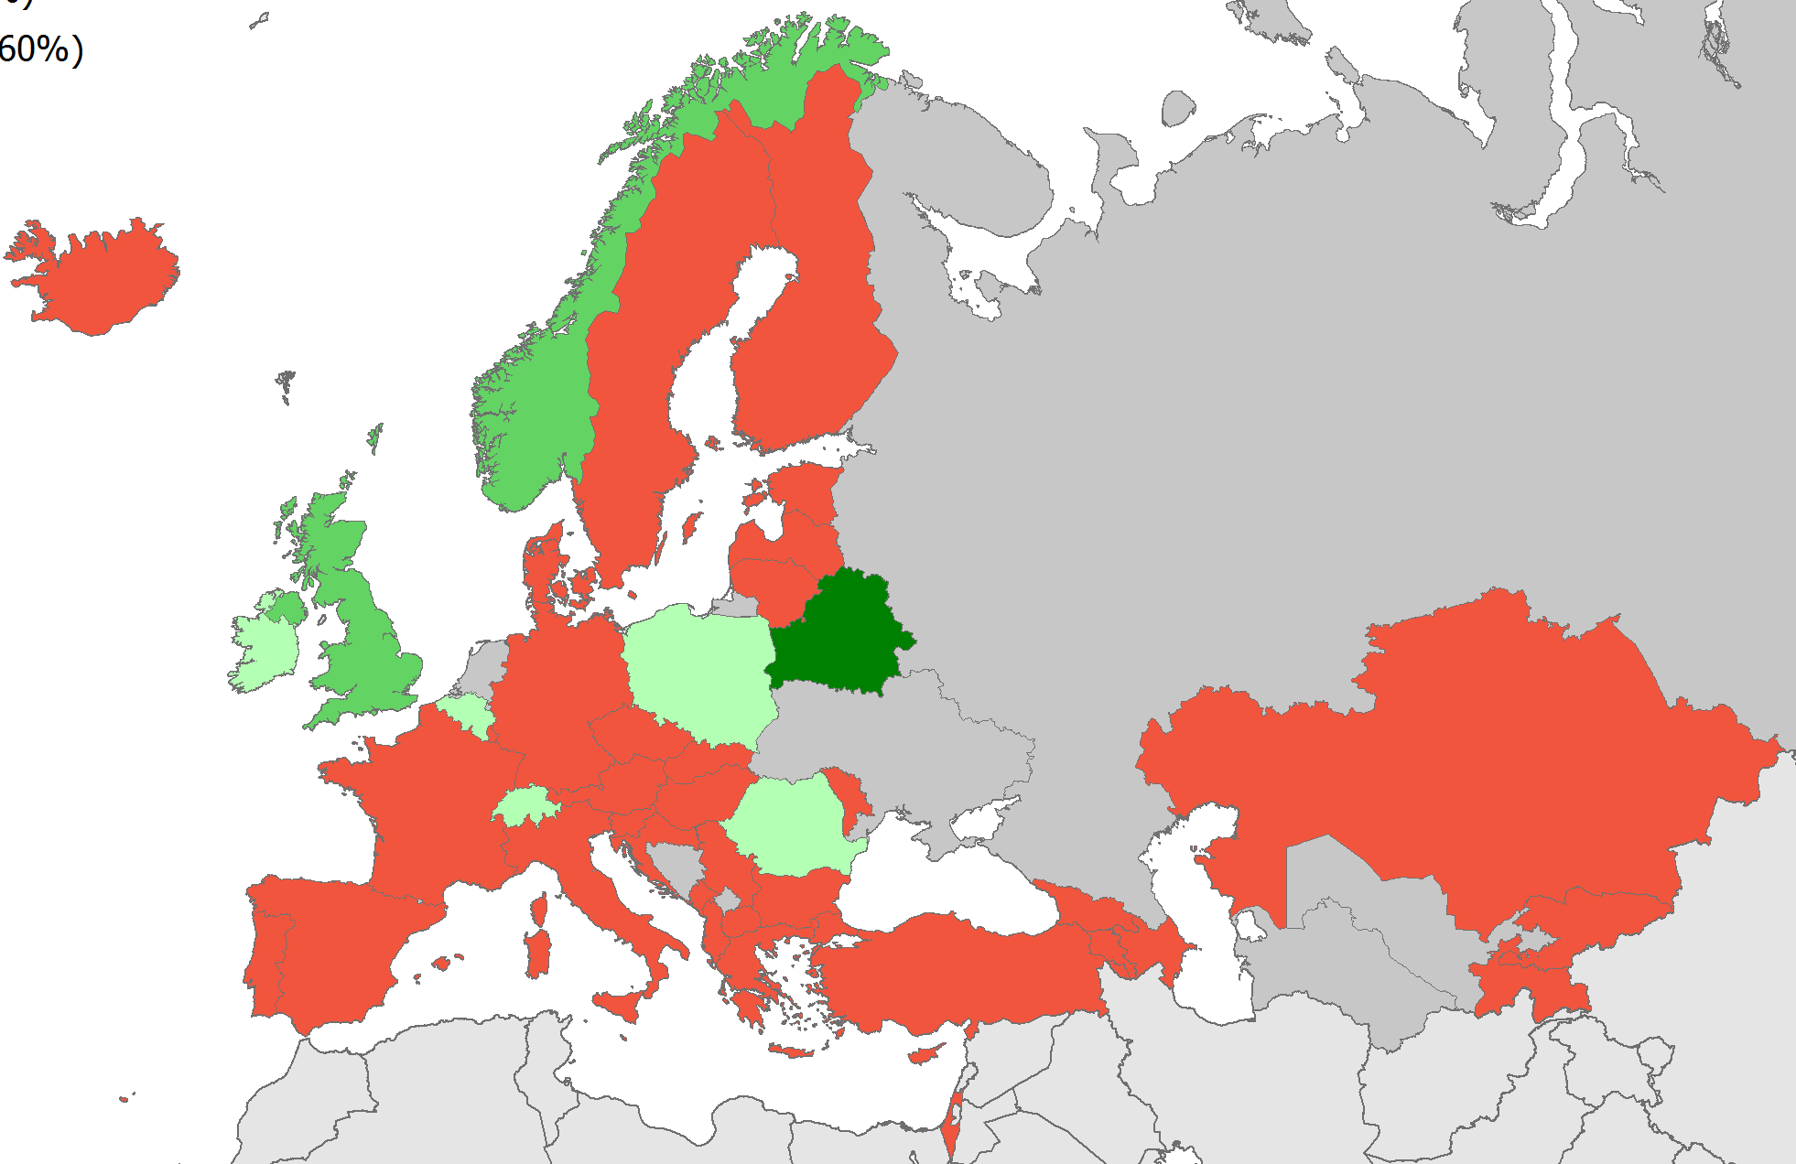
Implementation of self-sampling in Europe and Central Asia, 2018
Source: ECDC. Dublin Declaration monitoring 2018; validated unpublished data.

Slide 10
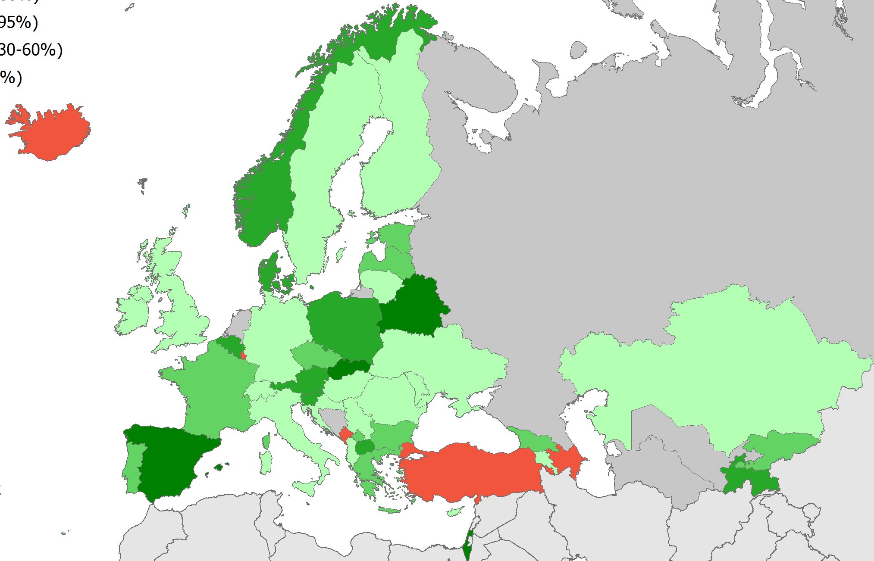
Implementation of community-based testing by trained medical staff in Europe and Central Asia, 2018
Source: ECDC. Dublin Declaration monitoring 2018; validated unpublished data.

Slide 11
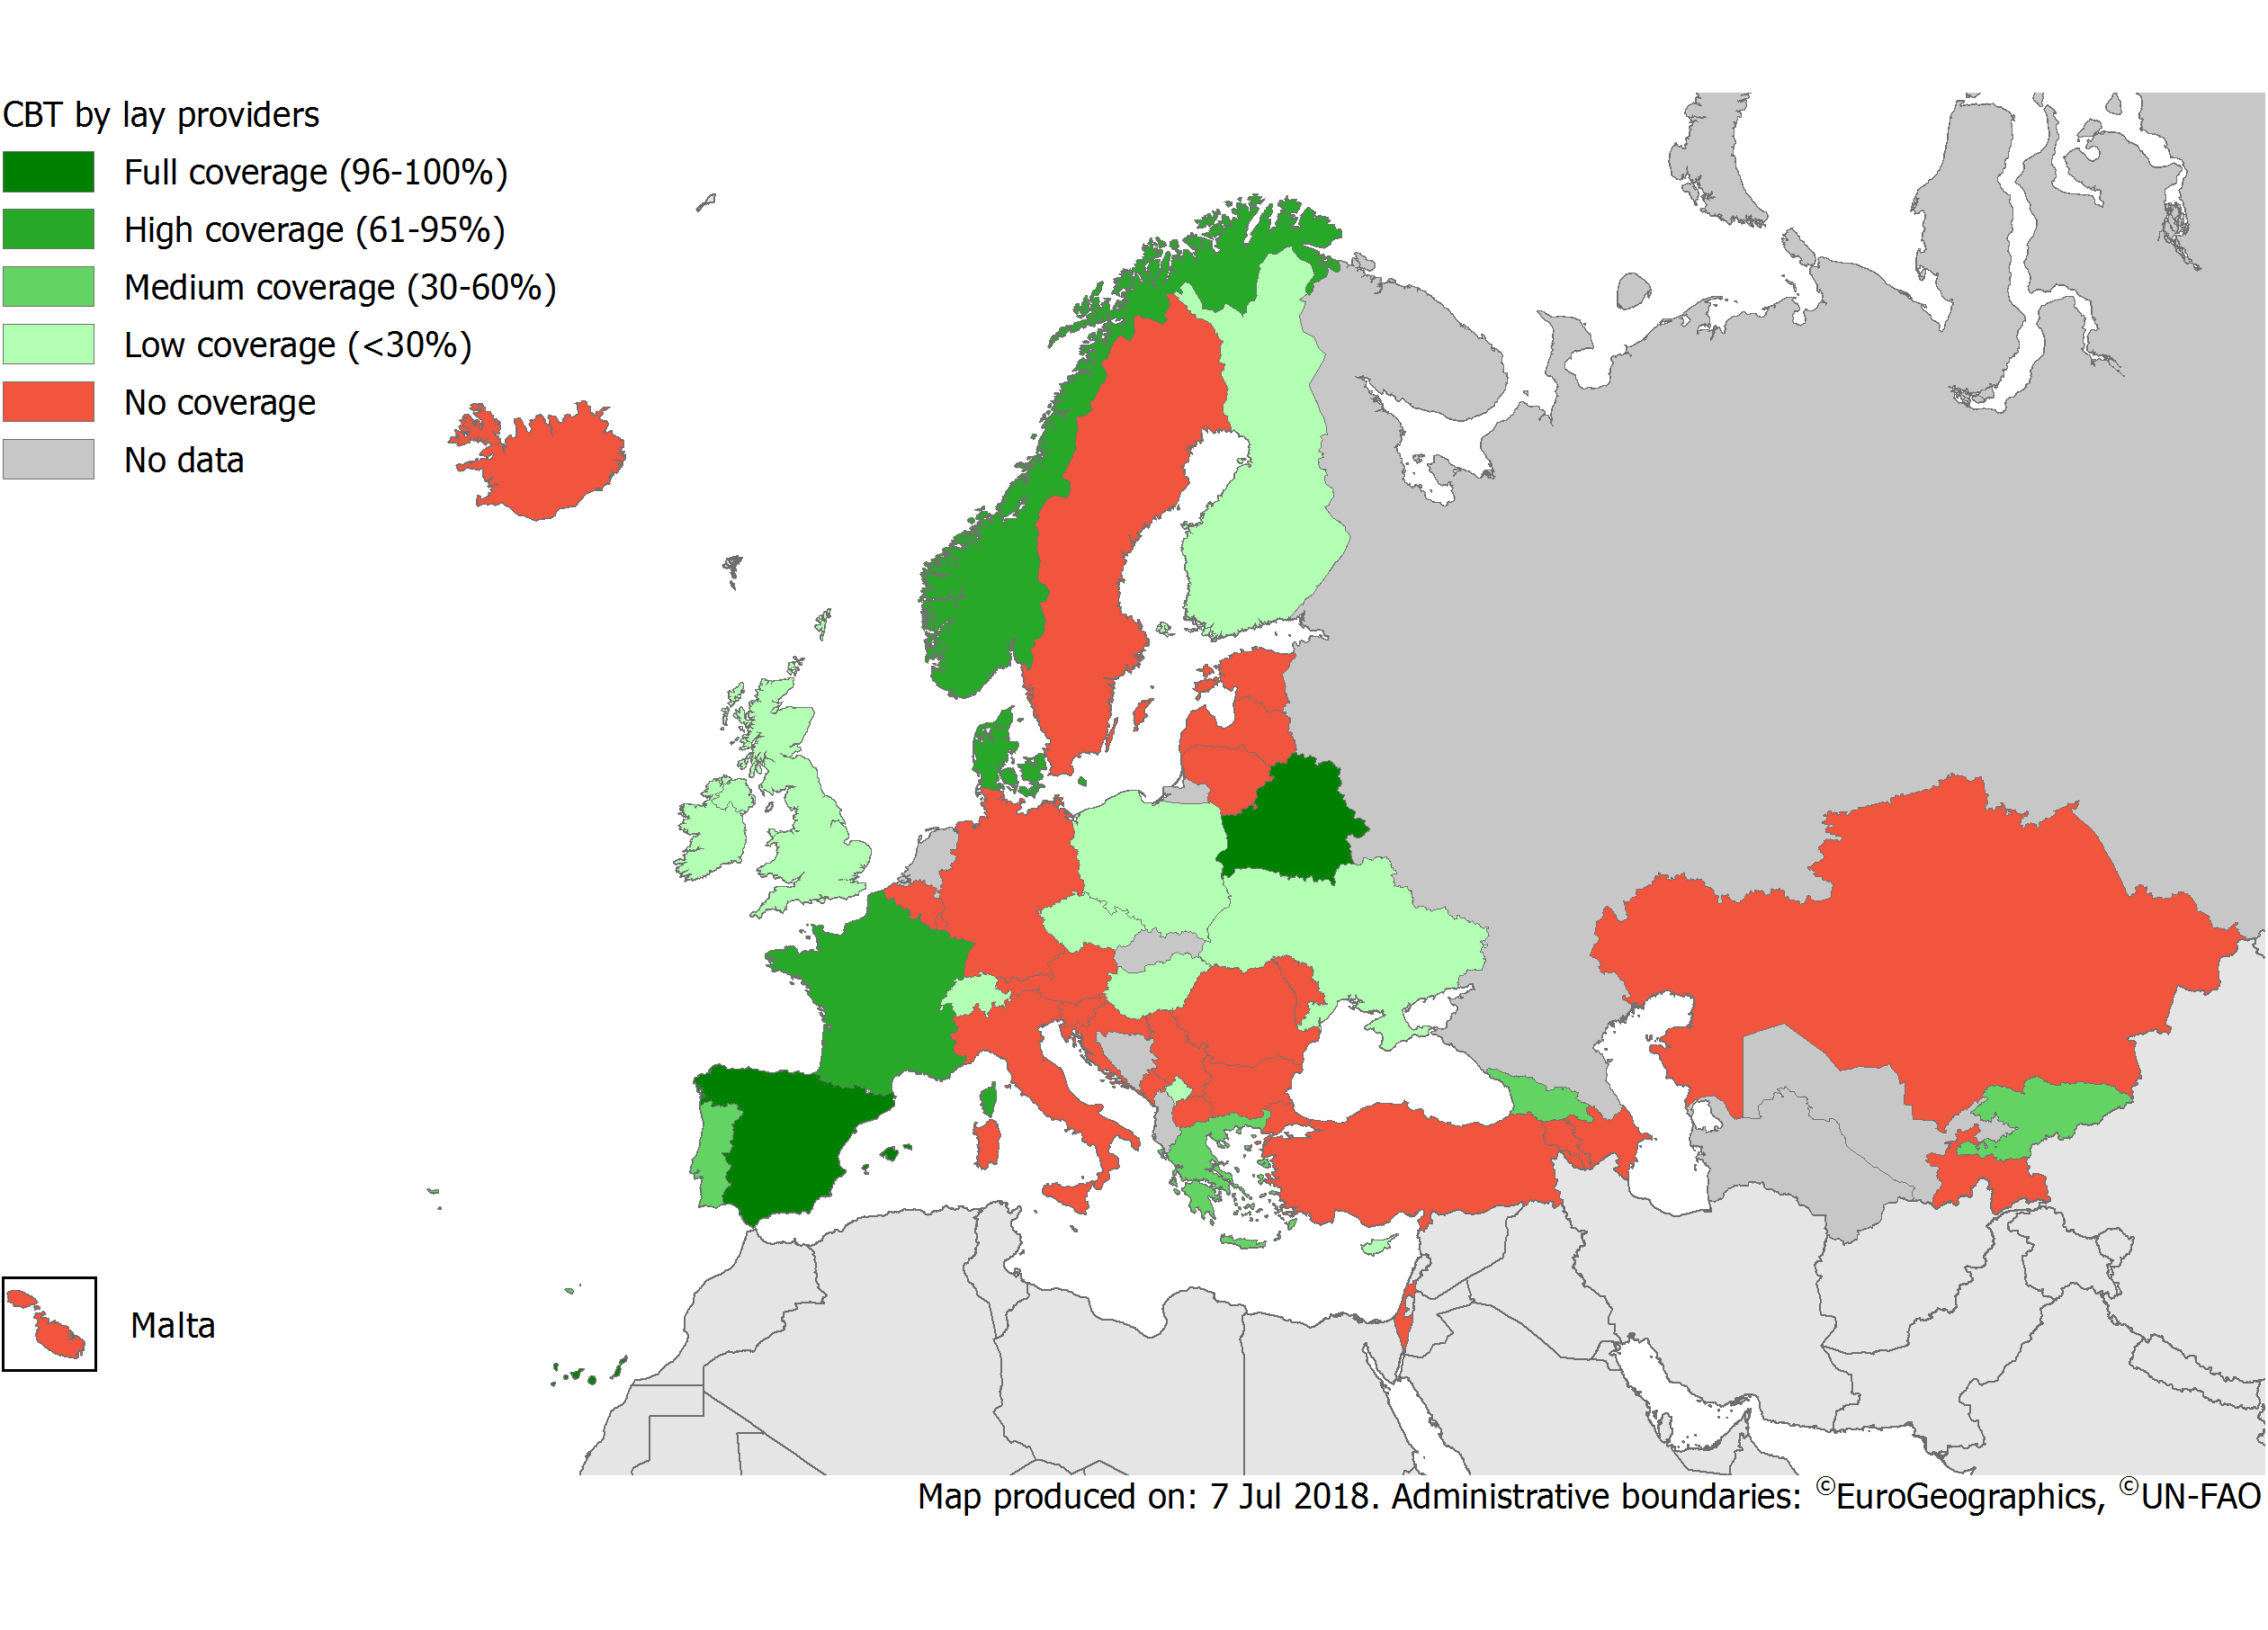
Implementation of community-based testing by lay providers in Europe and Central Asia, 2018
Source: ECDC. Dublin Declaration monitoring 2018; validated unpublished data.

Slide 12
Countries that collect data to monitor HIV testing interventions (n=50), 2018
Percentage
Source: Dublin Declaration Monitoring Country reports, 2018 – preliminary analysis .

Slide 13
In the last two years, what has your country done to address barriers to testing? (n= 50), 2018
Percentage
Source: Dublin Declaration Monitoring Country reports, 2018 – preliminary analysis .

Slide 14
Fast Track Targets by 2020
Target 1
Target 2
Target 3
Overall target
73%
of all people living with HIV
VIRALLY SUPPRESSED
=
living with HIV
DIAGNOSED
diagnosed with HIV
ON ART
on ART
VIRALLY SUPPRESSED

Slide 15
Progress toward achieving the second 90: Target 2: 90% of those diagnosed on ART (n=40)
Global target 90%
Regional average 64%
West 90%
Centre 73%
East 46%
Source: ECDC. Dublin Declaration monitoring 2018; validated unpublished data.

Slide 16
Fast Track Targets by 2020
Target 1
Target 2
Target 3
Overall target
73%
of all people living with HIV
VIRALLY SUPPRESSED
=
living with HIV
DIAGNOSED
diagnosed with HIV
ON ART
on ART
VIRALLY SUPPRESSED

Slide 17
Progress toward achieving the third 90: Target 3: 90% of those on ART virally suppressed (n=35)
Global target 90%
Regional average 85%
West 92%
East 78%
Centre 74%
Source: ECDC. Dublin Declaration monitoring 2018; validated unpublished data.

Slide 18
Fast Track Targets by 2020
Target 1
Target 2
Target 3
Overall target
73%
of all people living with HIV
VIRALLY SUPPRESSED
=
living with HIV
DIAGNOSED
diagnosed with HIV
ON ART
on ART
VIRALLY SUPPRESSED

Slide 19
Progress toward achieving the 90-90-90: Overall target: 73% of all PLHIV virally suppressed (n=34)
Regional average 43%
Global target 73%
West 72%
Centre 45%
East 26%
Source: ECDC. Dublin Declaration monitoring 2018; validated unpublished data.

Slide 20
How close are we to reaching the 90-90-90 targets?
EU/EEA
90 91
2018 data
90%
81%
73%
Source: ECDC. Dublin Declaration monitoring 2018; validated unpublished data.
Notes:
While the Western part of the region is closing in on reaching the 90-90-90 targets, the Central and Eastern parts are lagging behind
Significant variation along all steps of the continuum between and within the sub-regions of Europe
For EU/EEA: 86-90-91

Slide 21
Acknowledgements
Dublin Declaration advisory group
Kristi Ruutel (Estonia), Daniela Rojas Castro (France), Gesa Kupfer (Germany), Caroline Hurley (Ireland), Silke David (Netherlands), Arild Johan Myrberg (Norway), Isabel Aldir, Daniel Simoes (Portugal), Irene Klavs (Slovenia), Gabrella Hok (Sweden), Valerie Delpech, Alison Brown, Cary James, Brian Rice (United Kingdom), Olga Varetska (Ukraine), Jean-Luc Sion (European Commission), Dagmar Hedrich (EMCDDA), Taavi Erkkola, Kim Marsh (UNAIDS), Annemarie Steengard (WHO Regional Office for Europe), Jordi Casabona (INEGRATE), Axel J. Schmidt (ESTICOM).
Dublin Declaration focal points in Europe and Central Asia
Roland Bani (Albania), Jennifer Fernández Garcia (Andorra), Samvel Grigoryan, Arshak Papoyan (Armenia), Irene Rueckerl, Bernhard Benka, Robert Zangerle (Austria), Esmira Almammadova, Natig Zulfugarov (Azerbaijan), Inna Karabakh (Belarus), Andre Sasse, Dominique Van Beckhoven (Belgium), Dušan Kojić, Indira Hodžić (Bosnia and Herzegovina), Tonka Varleva (Bulgaria), Jasmina Pavlic (Croatia), Ioannis Demetriades (Cyprus), Veronika Šikolová, Hana Janatova (Czech Republic), Jan Fouchard (Denmark), Kristi Rüütel, Liilia Lõhmus, Anna-Liisa Pääsukene (Estonia), Henrikki Brummer-Korvenkontio (Finland), Bernard Faliu (France), Maia Tsereteli, Otar Chokoshvili, Ana Aslanikashvili (Georgia), Gesa Kupfer, Ulrich Marcus, (Germany), Dimitra Paraskeva, Vasilios Raftopoulos, Stavros Patrinos, (Greece), Maria Dudas, Katalin Szalay (Hungary), Guðrún Sigmundsdóttir, Þórólfur Guðnason (Iceland), Caroline Hurley, Fiona Lyons, Derval Igoe, Helen Deely, (Ireland), Daniel Chemtob, Yana Roshal (Israel), Anna Caraglia, Francesco Maraglino, Barbara Suligoi, Lella Cosmaro, (Italy), Alla Yelizarieva, Aliya Bokazhanova (Kazakhstan), Laura Shehu, Pashk Buzhala (Kosovo*), Aikul Ismailova, Nazgul Asylalieva (Kyrgyzstan), Šarlote Konova (Latvia), Andrea Leibold. Marina Jamnicki Abegg (Liechtenstein), Irma Caplinskiene (Lithuania), Patrick Hoffman, Pierre Weicherding (Luxembourg), Milena Stefanovic, Vladimir Mikic (FYROM), Jackie Maistre Melillo (Malta), Iulian Oltu, Svetlana Popovici, Tatiana Cotelnic (Moldova), Alma Cicic, Aleksandra Marjanovic (Montenegro), Silke David (Netherlands), Arild Johan Myrberg (Norway), Anna Marzec- Bogusławska, Iwona Wawer, Piotr Wysocki, Magdalena Rosinska (Poland), Isabel Aldir, Teresa Melo (Portugal), Mariana Mardarescu, Adrian Streinu-Cercel (Romania), Danijela Simic, Sladjana Baros (Serbia), Jan Mikas, Peter Truska, Helena Hudecová, (Slovakia), Irena Klavs, Janez Tomažič (Slovenia), Begona Rodriquez Ortiz de Salazar (Spain), Louise Mannheimer, Gabriella Hok, (Sweden), Axel J. Schmidt, Sabine Basler (Switzerland), Zukhra Nurlaminova, Sayfuddin Karimov, Dilshod Sayburhonov (Tajikistan), Emel Özdemir Şahin (Turkey), Valerie Delpech (United Kingdom), Igor Kuzin (Ukraine) and Zulfiya Abdurakhimova (Uzbekistan).
HIV Surveillance focal points in the EU/EEA
Daniela Schmid, Alexander Spina (Austria), Andre Sasse (Belgium), Tonka Varleva (Bulgaria), Tatjana Nemeth Blazic (Croatia); Maria Koliou (Cyprus), Marek Maly (Czech Republic); Susan Cowan (Denmark), Kristi Ruutel (Estonia), Kirsi Liitsola (Finland), Florence Lot (France), Barbara Gunsenheimer-Bartmeyer (Germany), Georgios Nikolopoulos and Dimitra Paraskeva (Greece), Maria Dudas (Hungary), Gudrun Sigmundsdottir and Haraldur Briem (Iceland), Kate O’Donnell and Derval Igoe (Ireland), Barbara Suligoi (Italy), Šarlote Konova (Latvia), Saulius Čaplinskas and Irma Čaplinskienė (Lithuania), : Jean-Claude Schmit (Luxembourg), Jackie Maistre Melillo and Tanya Melillo (Malta), Eline Op de Coul (Netherlands), Hans Blystad (Norway), Magdalena Rosinska (Poland), Helena Cortes Martins (Portugal), Mariana Mardarescu (Romania), Peter Truska (Slovakia), Irena Klavs (Slovenia), Asuncion Diaz (Spain), Maria Axelsson (Sweden), Valerie Delpech (United Kingdom).
EuroCoord/ECDC project collaborators
Daniela Schmid, Alexander Spina, Robert Zangerle (Austria), Andre Sasse, Dominique Van Beckhoven (Belgium), Susan Cowan, Niels Obel (Denmark), Florence Lot, Francoise Cazein, Dominique Costagliola, Virginie Supervie (France), Barbara Gunsenheimer-Bartmeyer (Germany), Georgios Nikolopoulos, Giota Touloumi (Greece), Barbara Suligoi, Antonella d’ Arminio Monforte, Enrico Girardi (Italy), Eline Op de Coul, Peter Reiss, Ard van Sighem (Netherlands), Mercedes Diez, Asuncion Diaz, Julia Del Amo (Spain), Maria Axelsson, Anders Sӧnnerborg (Sweden), Valerie Delpech, Sara Croxford, Caroline Sabin (United Kingdom)
Notes:
I

Slide 22
Thank you
Teymur Noori
Rosalie Hayes
Yusef Azad
Alison Brown
Valerie Delpech
Anastasia Pharris

